Slide 1
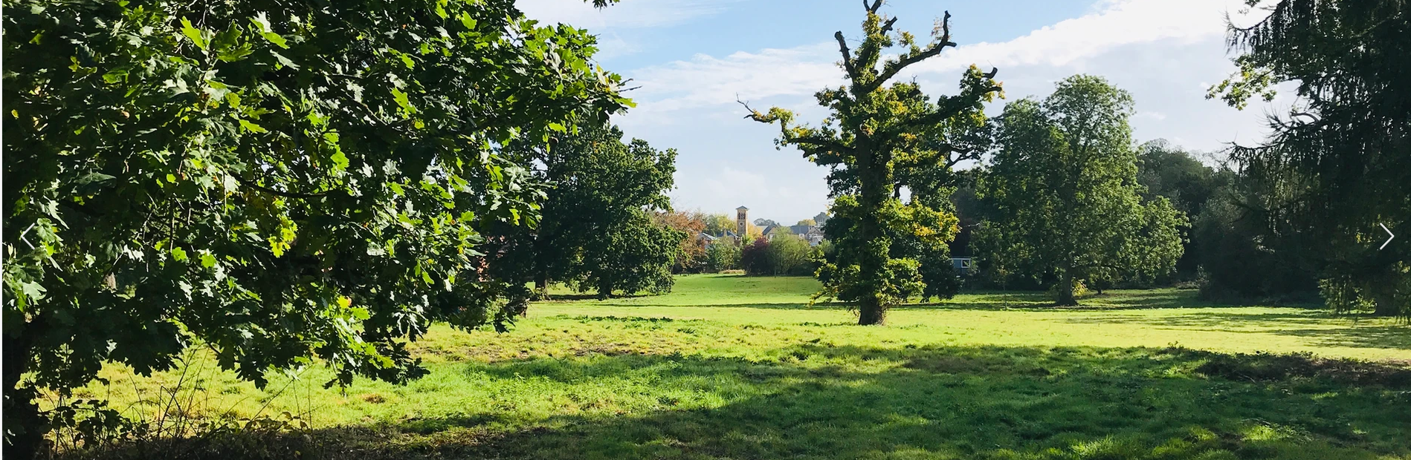


Leybourne Grange Management CIC
Amendments to The Articles of Association
Explanation Ahead of the Extraordinary General Meeting (EGM)
21st January 2025
SallyAnne Logan, Independent Chair
Notes:
Welcome to this short film clip which provides residents with further information about the proposed amendments to the Articles of Association to be voted on by LGM CIC Members on 21st January 2025.
This presentation will enable residents to have a greater understanding of the changes proposed and why they are needed.
My name is SallyAnne Logan and I am the Independent Chair of the Board. This presentation is brought to you on behalf of the Board of Directors who are all resident members of Leybourne Chase and who are ultimately responsible for safeguarding the CIC in terms of ensuring it carries out its roles and responsibilities, which includes ensuring financial stability.

Slide 2


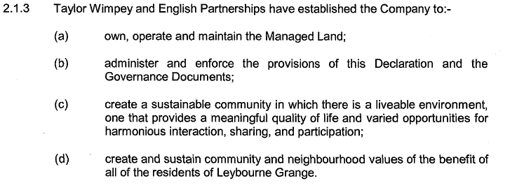

Mission
Statement
The Community Trust Declaration states;
Notes:
LGM CIC was set up by Taylor Wimpey and Homes England to be the local community stewardship body to own, maintain and management assets on behalf of the 733 households who call Leybourne Chase home and for all those who live and work here. LGM CIC is responsible for the community assets and manages and maintains them using receipts from the Service Charge income and income generated from leases and hire of our community buildings/spaces.
Being a Community Interest Company, LGM CIC has a board of volunteer directors who are responsible for safeguarding the CIC and its assets in perpetuity. This means carrying out good governance, robust financial management and providing residents with a programme of community development and engagement to meet their needs. Collectively, these actions will aid the creation of a healthy, vibrant and active community for all those who live here.
The CIC is governed by two key legal documents; the Community Trust Declaration and the Articles of Association. Both documents set out what the CIC can and cannot do and how it must do it. LGM CIC is more complicated than many other community organisations given the CDT and the extra responsibilities it places on the organisation and covenants on land provided to protect them for community use.
Every privately owned household/flat pays the SC and affordable housing providers too. This provides those people/organisations with membership of the CIC. Membership provides for a right to vote at the Annual General Meetings and Extraordinary General Meetings. It is important then that Members use their right to vote.
The Mission Statement on this slide sets of the roles and responsibilities of the CIC.

Slide 3

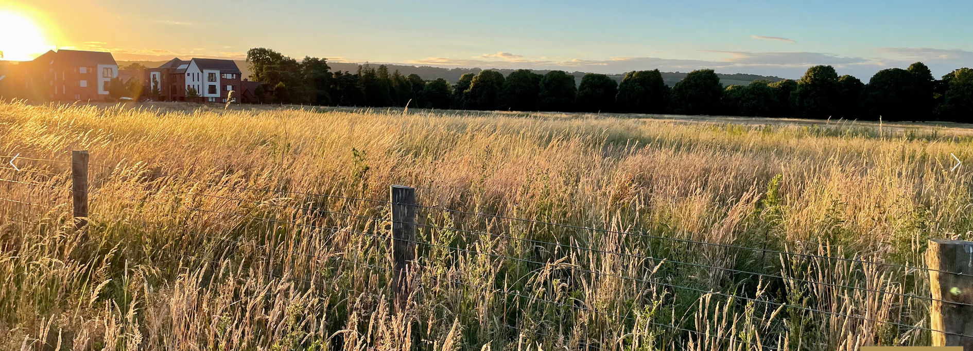
Achieving Good Governance and Operational Standards
Articles are out of date/not best practice standards
High quorum for AGM/EGM’s
High quorum for Board Meetings
Bring clarity to areas where the Articles are currently silent
HE drew a close to the EP period in early 2024
Anthony Collins Solicitors have advised the CIC on amendments
The current Articles and CDT can be found here ?????
Notes:
The Articles of Association have become outdated and out of step with best practice in recent years and most particularly since Covid when it is much more standard practice to carry out business online, using electronic methods for decision making and meetings. Whilst we already have the ability to hold virtual meetings, further clarity on this is helpful.
Some of the key challenges to the current Articles are set out on this slide;
Articles are out of date/not best practice standards
High quorum for AGM/EGM’s – and 10% of the total number of resident members AND the requirement for our affordable housing provider, Clarion, to be present to be quorate, this is challenging. Experience in 2024 highlighted how tough it is to achieve quorum despite robust approaches to communication and engagement
High quorum for Board Meetings – All board members (minimum five) must be present to be quorate. This simply isn’t realistic with the personal commitments of those on the board and with holiday and sickness and is not a usual approach across the voluntary sector. Amending this to a more flexible approach will bring benefits of more efficient decision making and effective governance
Clarity on the rights of members - ??????
Homes England closed the EP period in early 2024 meaning that the CIC’s board is now independent of HE and its structure can evolve to meet local need. This provides an opportunity to refine the governance arrangements, whilst remaining in the spirit of the original Articles and adhering to the CDT. As such, the Board of Directors instructed Anthony Collins, our solicitors, to prepare a revised set of Articles based on best practice and to include areas where the CIC is struggling to operate effectively, due to the current limitations and ‘rules’.

Slide 4
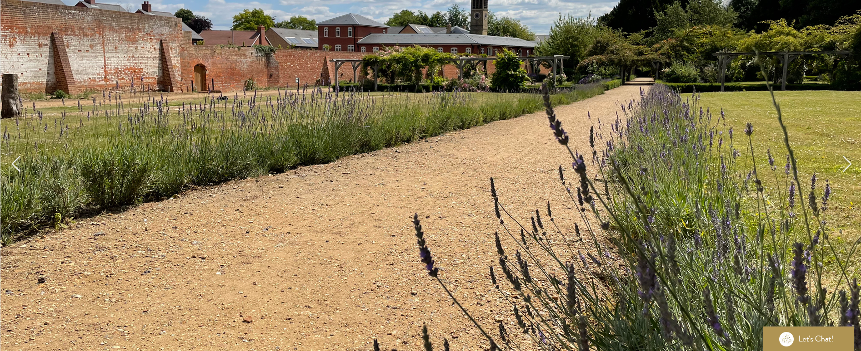
Why Change the Articles?
Currently too restrictive & not aligned to best practice
  Community Decision Making;
  Lower quorum to enable ease of decision making
  Easier and more efficient
  Clarity on members rights for leaseholders
  Improve resident engagement and influence
  Board Operations and Decision Making;
  Achieve and sustain good governance
  More efficient and effective
  Streamline decision making
  Ease of understanding
The CIC is Governed by The Office of the Regulator for Community Interest Companies
Notes:
So why do we want to change The Articles?
The CIC is currently stuck in a cycle of setting up AGM/EGM’s and not being able to meet its quorum to effect good community decision making. This is not good governance and is restricting the CIC and its members from progressing towards a more involved, collegiate and robust approach to community governance.
Until we can get over this hurdle, the work of the CIC will be hampered by complicated and time-consuming governance processes and procedures which is costing residents money as time and resource has to be spent on planning and replanning general meetings. WE NEED TO CHANGE THIS BUT NEED YOUR HELP TO DO SO.
You can help by attending the EGM on the 21st January and making your vote count!

Slide 5
What Is The Purpose of This Presentation?
  To set out the main and key changes proposed by the board of Directors
  Compare and contrast the existing Articles with the proposed new
  Help Members to understand why we need attendance at the EGM on the 21st January
  Help Members consider their decision ahead of the EGM and to be more informed of their choices
  Keep the EGM on the 21st to a maximum of an hour
  Inform residents on HOW to register to attend the EGM
Notes:
CIC is currently stuck in a cycle of setting up AGM/EGM’s and not being able to meet its quorum to effect good community decision making. This is not good governance and is restricting the CIC and its members from progressing towards a more involved, collegiate and robust approach to community governance.
The Articles and Community Trust Declaration are further supported and underpinned by Company Law which provides further rules and regulations relating to how the CIC can operate.
Until we can get over this hurdle, the work of the CIC will be hampered by complicated and time-consuming governance processes and procedures which is costing residents money as time and resource has to be spent on planning and replanning general meetings. WE NEED TO CHANGE THIS BUT NEED YOUR HELP TO DO SO

Slide 6

Proposed Article Amendments – Board Governance
Existing Articles – Board Governance (directors)
Proposed Articles – Board Governance (directors)
  Current quorum of five
  Minimum number of appointed directors is five
  No term of appointment for directors & no repeat term for directors
  No provision for minimum director attendance at board meetings
  Clarion has a right to appoint director
  No link between ability to be a director and debt/adherence to the Community Standards
Minimum of two directors must be present to be quorate (Clause 16.2)
Minimum number of appointed directors is three and a maximum of 12 (Clause 23.1)
Three-year term plus a maximum of two repeat terms (Clause 23.2)
Directors can be removed if they do not attend three consecutive meetings (Clause 24.1.2)
Removal of Clarions’ right to appoint a director
Clarity on the ability to appoint non-exec chair (paid or voluntary) who is non-voting (Clause 10.2)
Ability to remove a director who is in Service Charge or other debt to the CIC or is in breach of the Community Standards (24.1.9)
Notes:
Quorum is the number of directors who must be present to hold a meeting and make decisions. We currently have to have a minimum of five directors to be quorate and have five appointed directors in total. This means everyone has to be present to hold a meeting and make decisions. This is not practical or reasonable given the voluntary nature of the roles and other commitments which directors have. It means that Board meetings can sometimes be cancelled at the last minute due to sickness or other matters and therefore decisions are delayed or become more complicated by having to follow other governance procedures for electronic decision making. A lower quorum would be more operationally sound.
Clarion currently has a right to appoint a director to the Board. This relates back to the Community Trust Declaration and the development period/EP provisions. Whilst the CIC remain committed to working with Clarion to ensure the participation of affordable housing tenants in the work of the CIC, the right to have a director has been removed. Clarion can still be a director (as a member) but with following the same caveats and processes of other Members. Board would probably opt to have Clarion as a director to bridge the gap between affordable housing tenants who do not have a right to vote, thus ensuring we capture their views, opinions and try meet their needs.

Slide 7

Proposed Article Amendments - AGM/EGM Governance
Current General/EGM Meeting Governance
Proposed General/EGM Meeting Governance
10 % quorum (59 members to be present)
Clarion must be present to be quorate
Silent on resident debt and voting rights
Lack of clarity on use of electronic means for General/EGM meetings
5% quorum (30 members to be present)(Clause 34.1)
Removal of Clarion’s presence to be quorate
Residents in debt to the SC can’t vote unless agreed by Board in advance (39.4)
Better definition on use of electronic means for General/EGM meetings (Clauses 33.3-33.5)

Slide 8
Proposed Article Amendments - Membership
Current Membership Rights
Proposed Membership Rights
Lack of clarity on how to become a Member eg membership form and/or signing of the Deed of Adherence
No clause on removal of Members for behaviour which could be harmful to the CIC
Use of complex language on private leaseholder members rights
Clarity provided – signature to Deed of Adherence constitutes membership of the CIC. Membership form or other form required by Board can be requested but DofA is baseline (clause 27.6)
New clause included. This is now seen as a standard approach to protect the CIC (clause 28.2.3)
Better link between Articles and CTD provided (clause 27.5)

Slide 9

Proposed Article Amendments – The Community Standards and Their Implementation
  There are no amendments as the detail to the operations of the Community Standards is held within the CTD.

Slide 10
Mechanics For The Hybrid EGM – 21st January 2025
6.30pm at The Sports Pavilion or via Board Pro
  There are three options. You can attend;
    In person at the Sports Pavilion
    Virtually via Board Pro
    Proxy in attendance
  In person – please arrive no later than 6.15pm to register attendance
  Virtual attendance requires a link to the meeting (please contact events@leybournechase.org a minimum of 24 hours before the EGM to register and receive the meeting link
  Proxy Vote (attendance by Proxy required) – form can be found at the end of EGM pack on the website and must be submitted no later than 5pm on 20th January 2025. You can tell your proxy how to vote or allow them to vote as they see fit
  Link to EGM Pack - News & Info | Leybourne Chase
Notes:
Named proxy vote – preferrable that this is a director of CIC or resident of Leybourne Chase as they will understand the context
free vote or tell them how to vote

Slide 11


Thank You For Listening!
If you have any further questions, please email them to chair@leybournechase.org
See you on the 21st January 6.30pm!
We are using new technology to host the EGM, so please bear with us if there are hitches on the night. Thank you.

